Slide 1

Android Architecture
JSPM NTC MCA Department

Slide 2

Overview
History of Android Architecture
Five Layers
▫ Linux Kernel
▫ Android Runtime
▫ Libraries
▫ Application Framework
▫ Applications
Summary

Slide 3

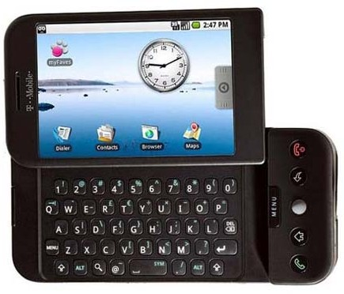
History
2003 –Founded
▫ No product for two years, funded by Andy Rubin
🞄 Planned the next generation of smartphones
🞄 Open source evolution of “Danger”
2005 – Purchased by Google
▫ Sooner or G1?
2007 – Publically announced
2008 – Sold first phone
G1

Slide 4

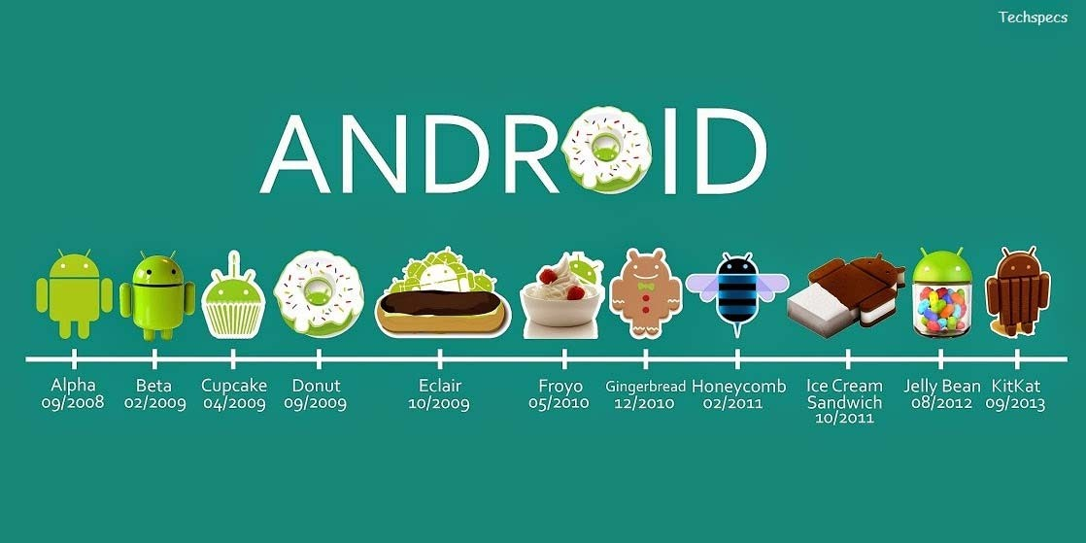


Previous Versions
Lollipop 09/2014
Marshmallow 09/2014

Slide 5

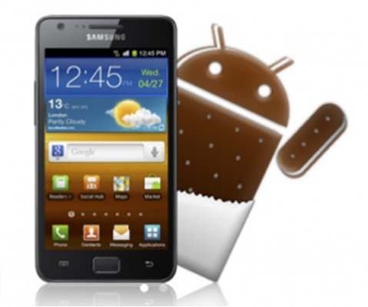
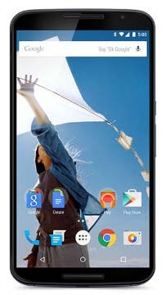
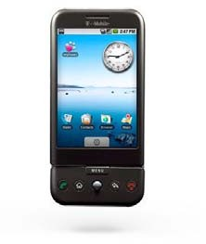
Previous Versions
Unnamed (1.0 + 1.1)
Cupcake (1.5)
Cupcake
Ice Cream Sandwich
Donut (1.6) – Quick Search Box
Lollipop
Éclair (2.1) – High Density Displays, Traffic + Navigation
Froyo (2.2) – Voice Control, Hotspot, Speed
Gingerbread (2.3) – Simpler, Battery Life, More apps
Honeycomb (3.0) – Flexible interface, tablets
Ice Cream Sandwich (4.0) - Customization
Jelly Bean (4.1) – Google Now, actionable notifications
KitKat (4.4) – “Ok Google”, voice control variety
Lollipop (5.0) – fluid tactile screens
Marshmallow (6.0) – battery life, app permissions, UI

Slide 6

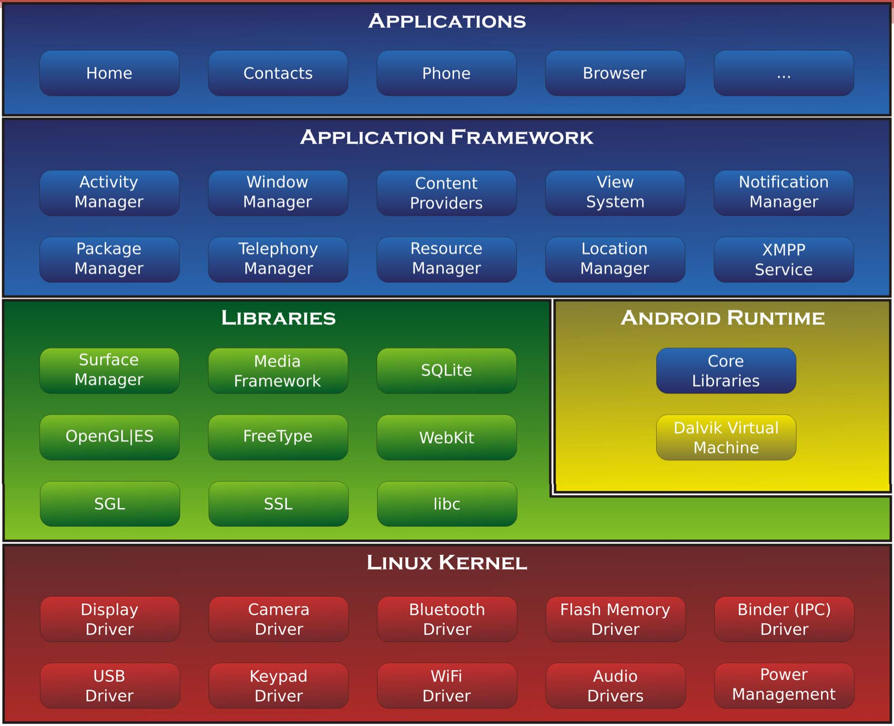

Slide 7




Slide 8


Linux Kernel
3.6 with ~115 patches
Generic System Services
▫ Permissions
▫ Memory and Process management
▫ File & Network I/O
▫ Device Drivers
Preemptive Multitasking
Lean, efficient, and secure
Open Source

Slide 9

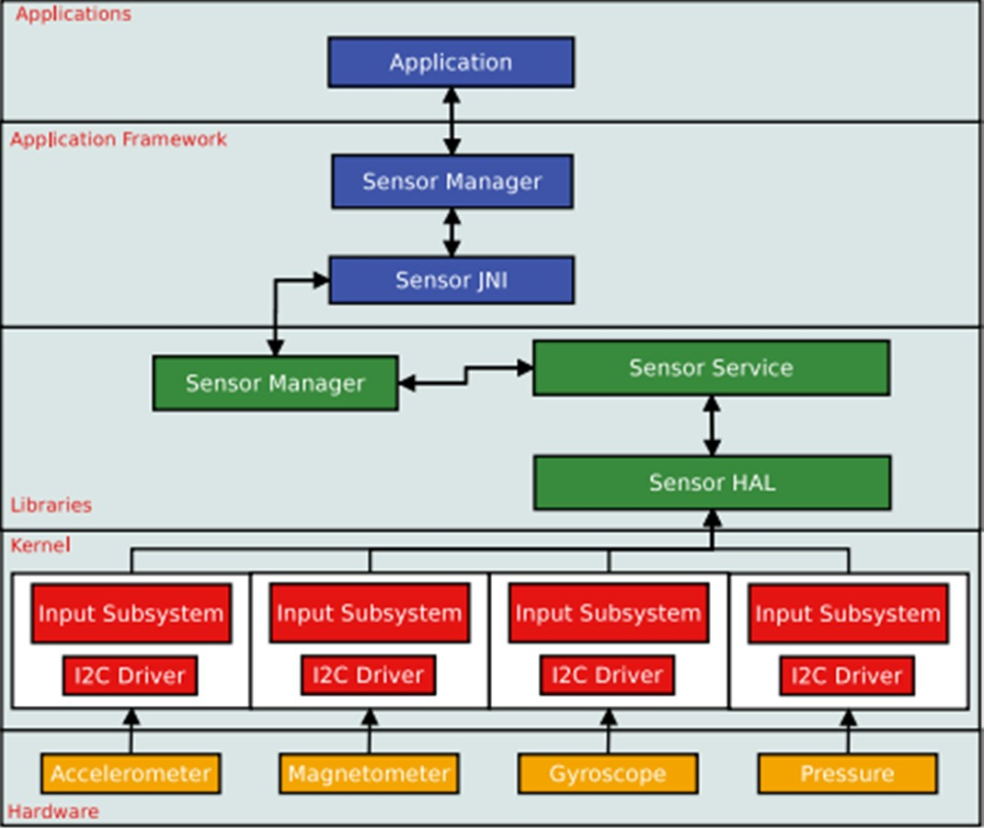
Hardware Abstraction Layer (HAL)
Software hooks between stack and hardware
Hardware Specific
▫ Allows Applications to be hardware ignorant

Slide 10





Slide 11

Android Runtime
Dalvik Virtual Machine
Core Java libraries
▫ Specific to Android development
🞄 Apple: Swift (Objective C)
🞄 Windows: Visual C++ (C++), Changes with OS
▫ Wrappers around C/C++ libraries
ART (Android Runtime VM)
▫ Replaced Dalvik in Lollipop (Android 5.0)
▫ Advantages over Dalvik
🞄 AOT (Ahead of Time) Compilation
🞄 Improved Garbage Collection

Slide 12

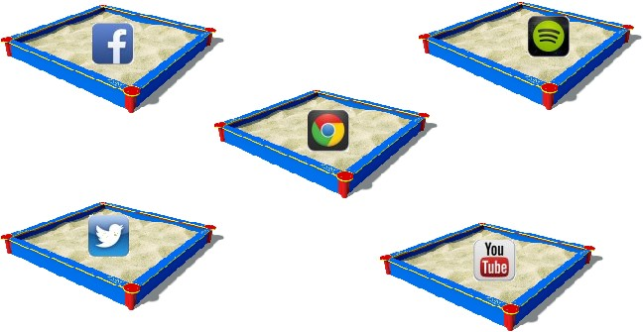
Dalvik Virtual Machine
Executes Android Applications
▫ Each Application runs within its own VM
🞄 Each app is “sandboxed”
Memory Management
Multi-threading

Slide 13





Slide 14


Libraries
C/C++
Play and record audio and video
Internet Security
User interface building
Graphics
Database access

Slide 15

Library Examples
WebKit
▫ Web Browser Engine
OpenGL
▫ High Performance Graphics
▫ Render 2D or 3D Graphic Content
libc
▫ Generic C library
SQLite
▫ Storage and sharing of application data

Slide 16

Library Examples Cont.
Surface Manager
▫ Off-screen buffering
🞄 Apps can’t directly draw into screen
🞄 Drawings go to off-screen buffer
🞄 Combined with other drawings
🞄 Reason behind window transparency
Media Framework
▫ Provides media codecs allowing recording and playback of different types of media

Slide 17




Slide 18

Application Framework
Higher Level Services to Applications
Environment in which applications are run and managed
Package Manager
▫ Keeps track of installed Applications
▫ Apps can communicate with other Apps on device
Window Manager
▫ Manages main window that comprises Application

Slide 19

Application Framework Cont.
View System
▫ Provide Common User Interface Elements
🞄 Icons
🞄 Buttons
🞄 Text Entry
🞄 Etc.
Content Providers
▫ Databases that allow application to store and share structured info

Slide 20

Application Framework Cont.
Location Manager
▫ Allows application to receive location and movement info generated by GPS
Activity Manager
▫ Manages activity life cycle of applications
Telephony Manager
▫ Manages all voice calls

Slide 21

Application Framework Cont.
Resource Manager
▫ Manage various types of resources used in applications
▫ Allows access to non-code embedded resources
🞄 Strings
🞄 Color settings
🞄 UI Layout
Notifications Manager
▫ Allows applications to display alerts

Slide 22



Slide 23







Applications
Hosts Android Applications
Written in Java
▫ Access to all Android APIs
Executed in the VM (Dalvik or ART)
Examples
▫ SMS client app
▫ Dialer
▫ Web Browser
▫ Contact manager

Slide 24
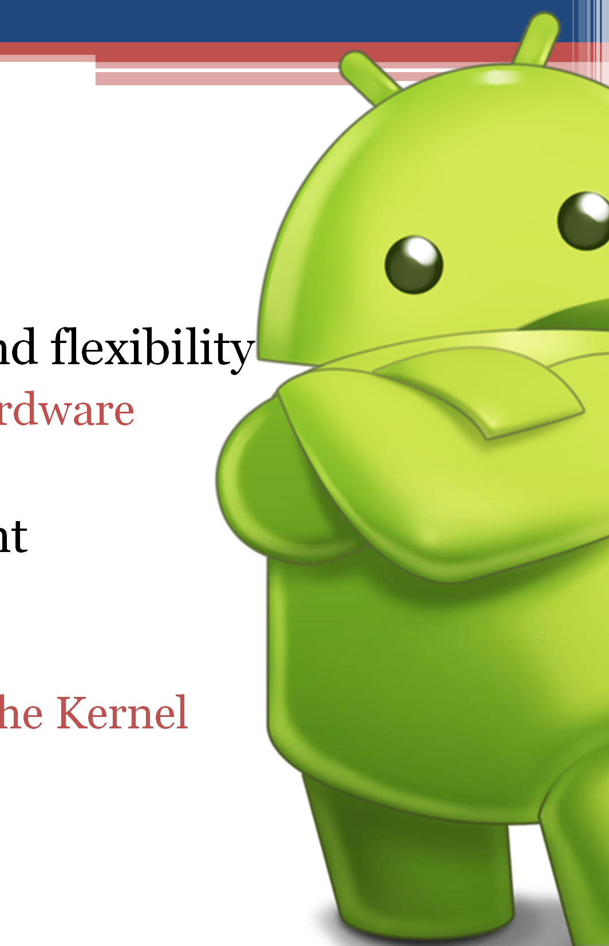

Conclusion
Designed for mobile and flexibility
▫ Both in software and hardware
5 Layers
Application Development
▫ Simple
🞄 Java
▫ Access to all aspects of the Kernel
🞄 Open Source
🞄 APIs

